Slide 1

Shivan A, Daniel , Jesus F, Mike A

Slide 2
Basic Functionalities
Search Movie
$sql = "Select * FROM MOVIES where title = '$MOVIENAME'";
Search Actors
$sql = "select MOVIES.title, MOVIES.production_year from MOVIES inner join cast_info on MOVIES.id = cast_info.movie_id and person_id = (SELECT id FROM ACTOR WHERE name = '$actor_name') order by MOVIES.production_year desc";
Search TV Shows
$sub = "SELECT id FROM TV WHERE title='$search'";
$sql = "SELECT title, season_nr, episode_nr FROM TV_episodes WHERE episode_of_id = ($sub) ORDER BY season_nr, episode_nr";
Insert a Movie
$sql = "INSERT INTO MOVIES (title,production_year) VALUE ('$title','$year')";
Remove Movie and TV SHOWS from watch list
Login Functionality
Through a users table
Track Active Users within the last 24 hours

Slide 3
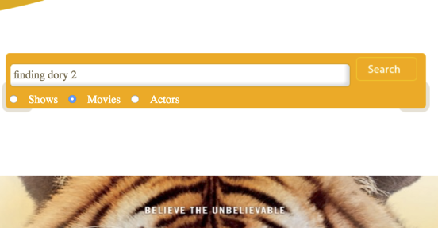
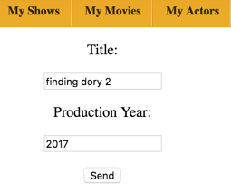
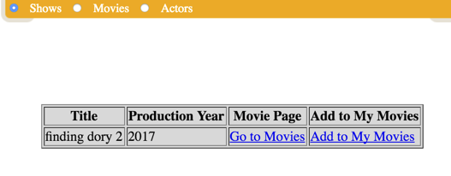
Scenarios - Search & Insert
Search - movies, TV shows, actors
Shivan wanted to search for his favorite movie Finding Dory 2.
Insert - movies
Shivan wanted to search for his favorite movie Finding Dory 2. He gets zero results, however, has the ability to insert it into the database to help future users.

Slide 4
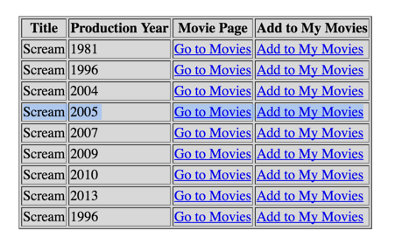
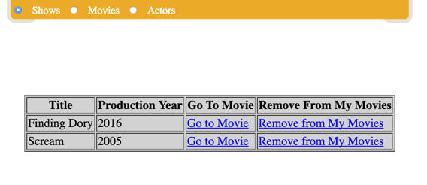
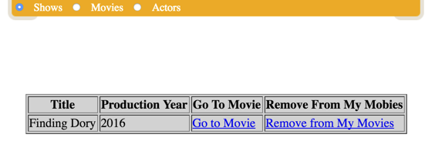
Scenarios - My Shows, My Movies, My Actors
Shivan wanted to add the movie he just watched, “Scream 5”, into his My Movies so that he can watch it some other time and get recommendations based on the genre Horror.

Slide 5
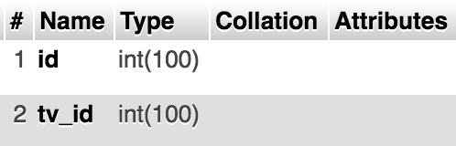
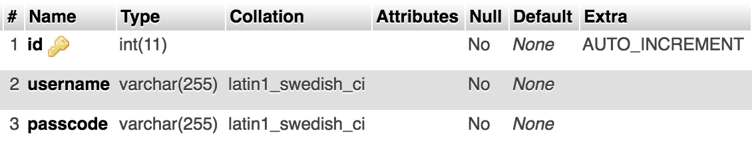
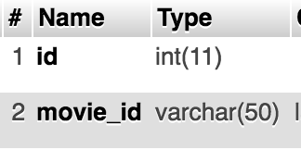
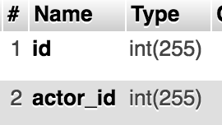
User(s)

Slide 6
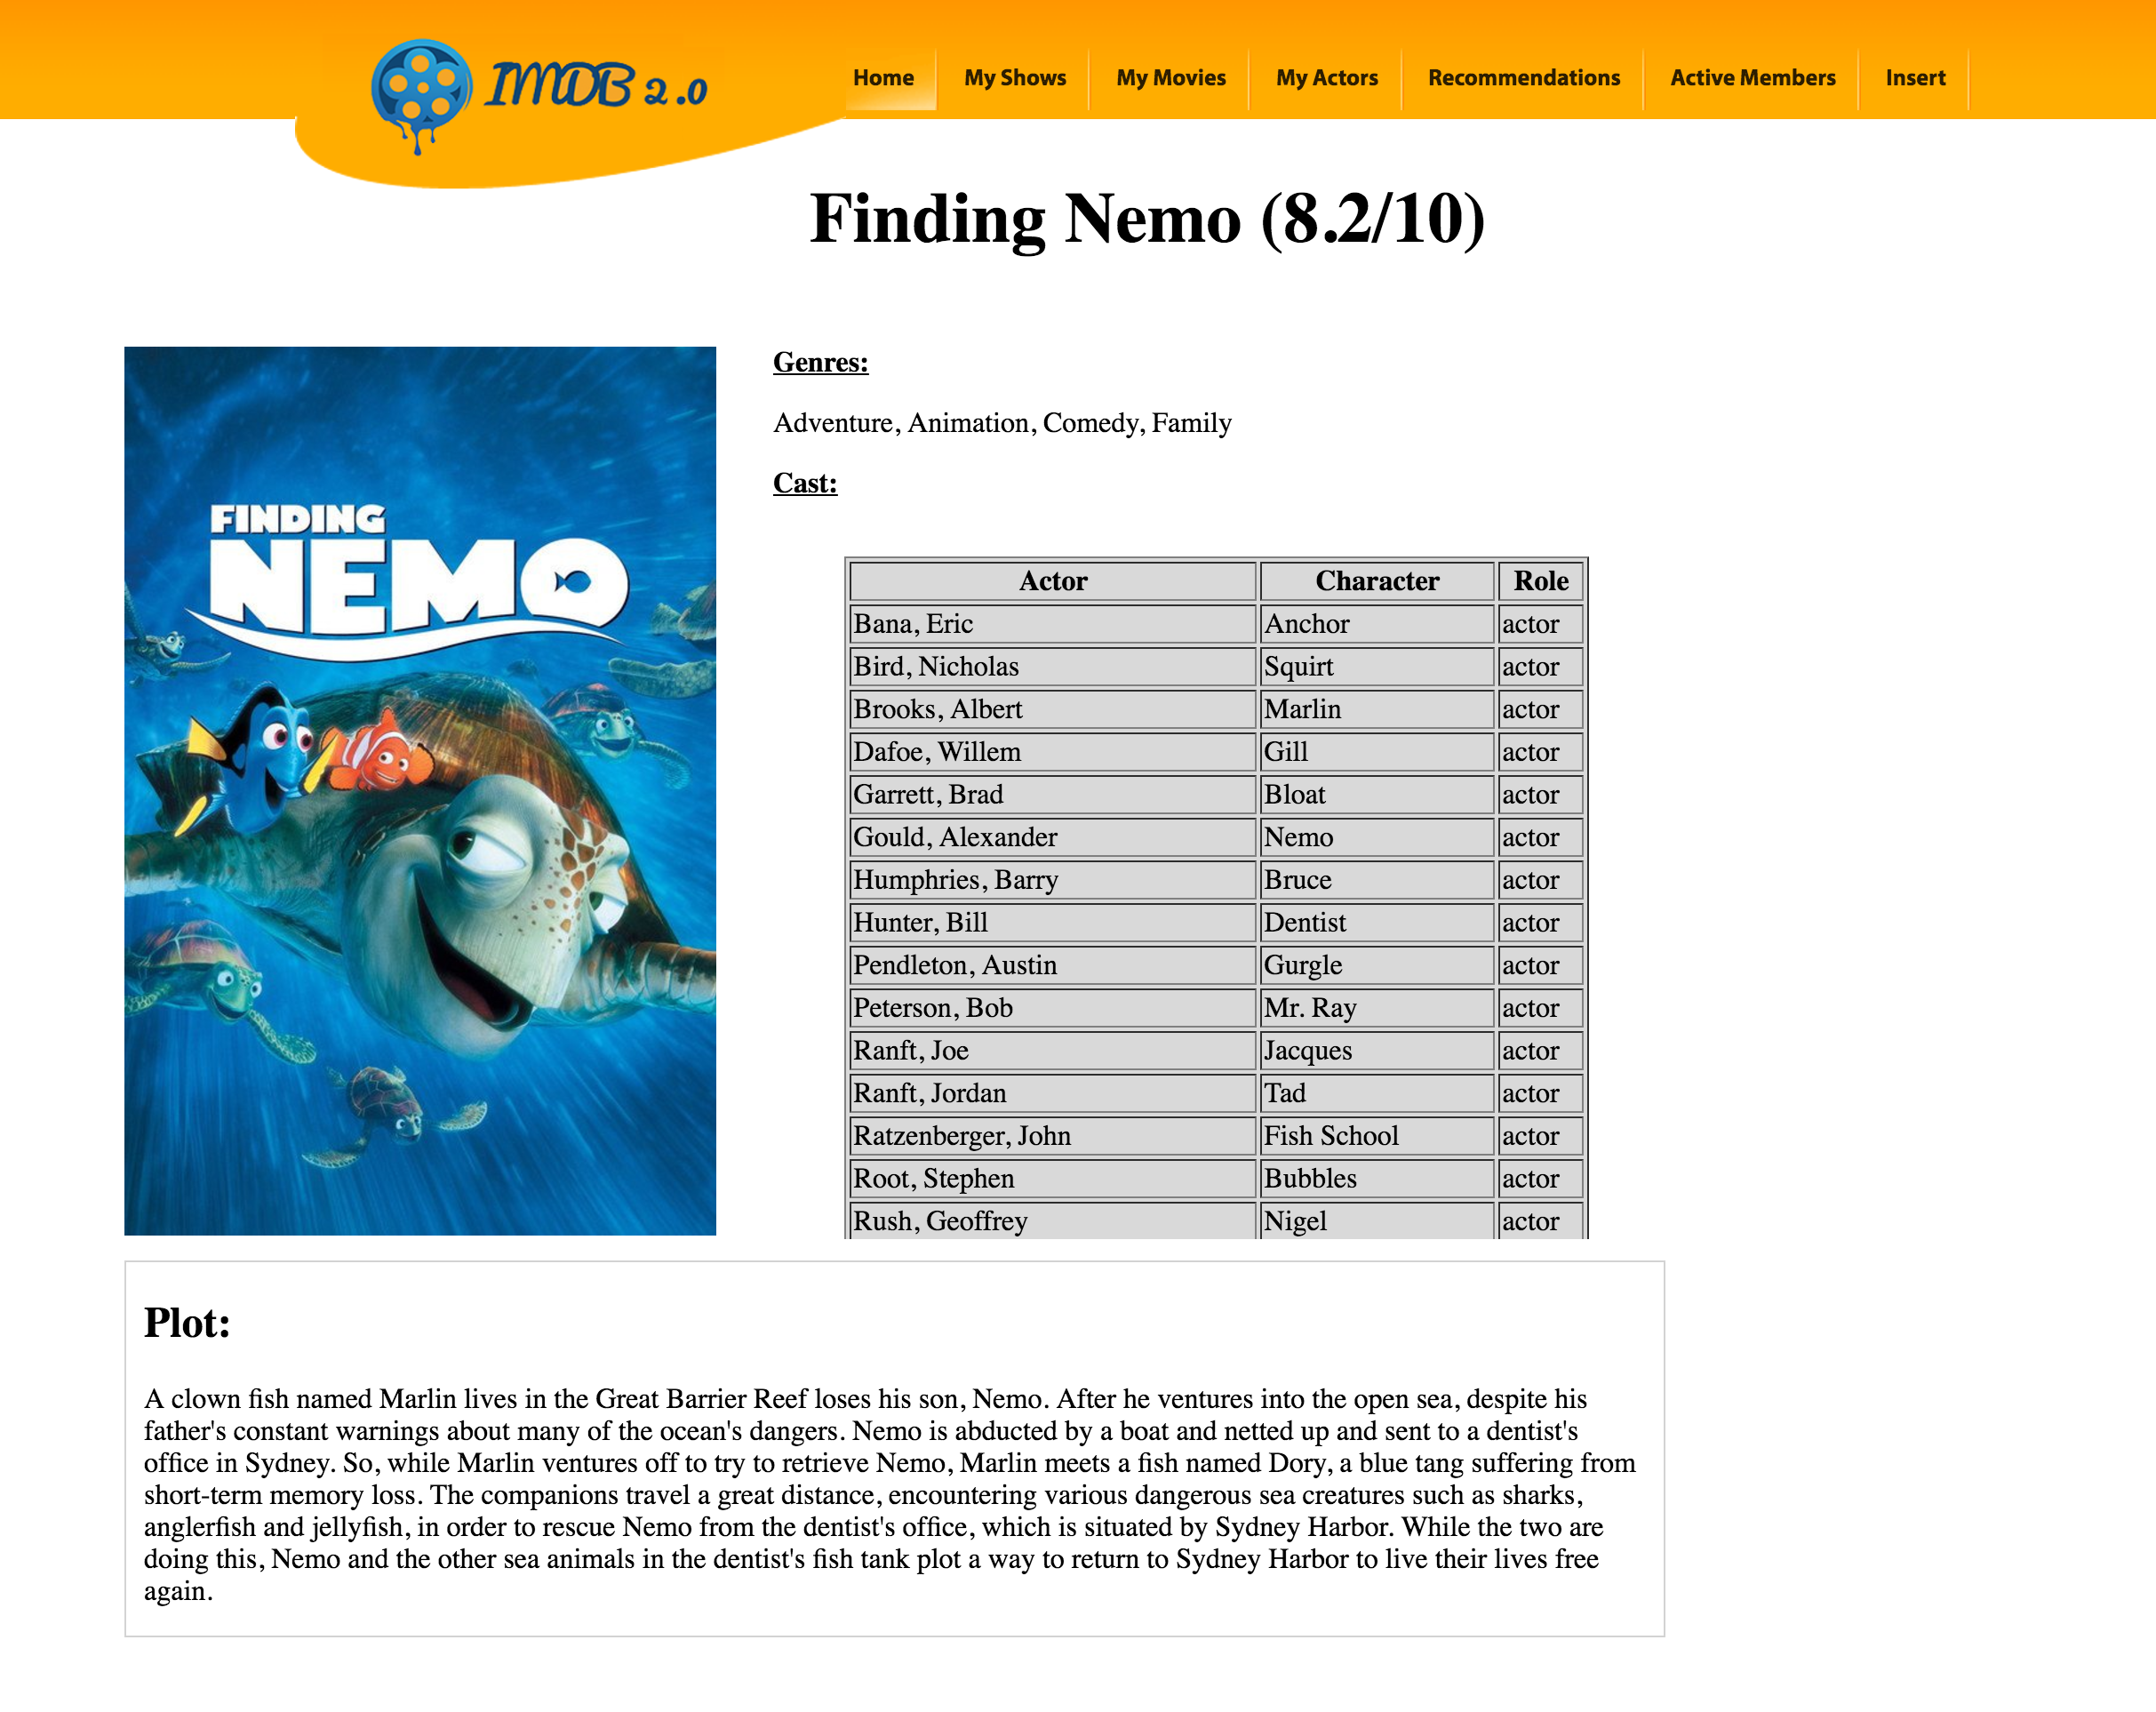
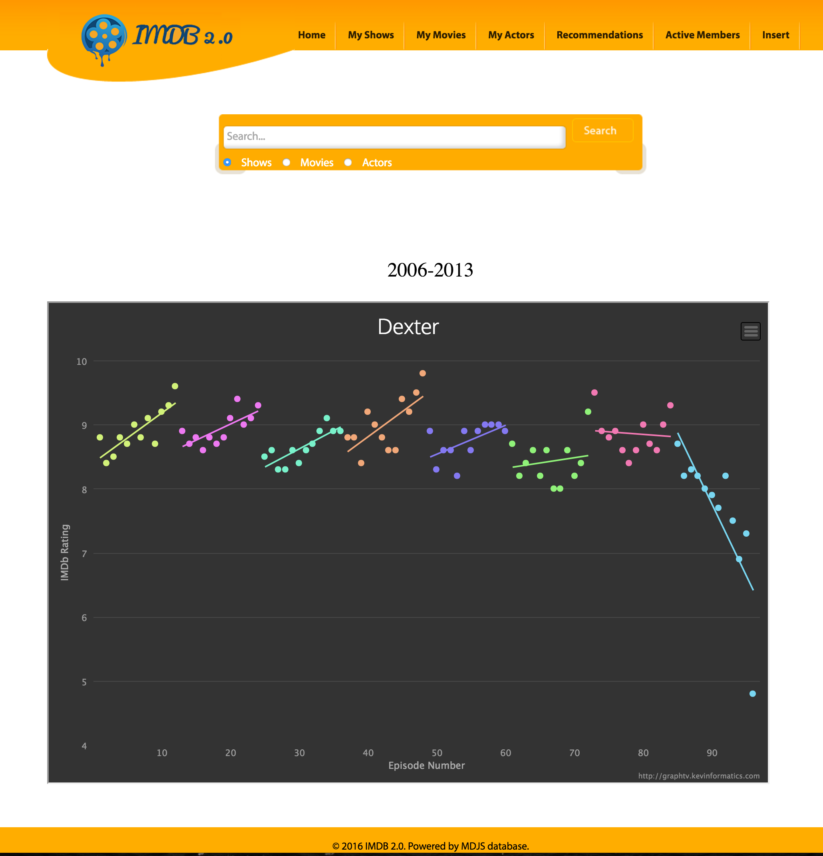
Use of API(s)
Grab Movie Poster
Graph of Season(s)

Slide 7
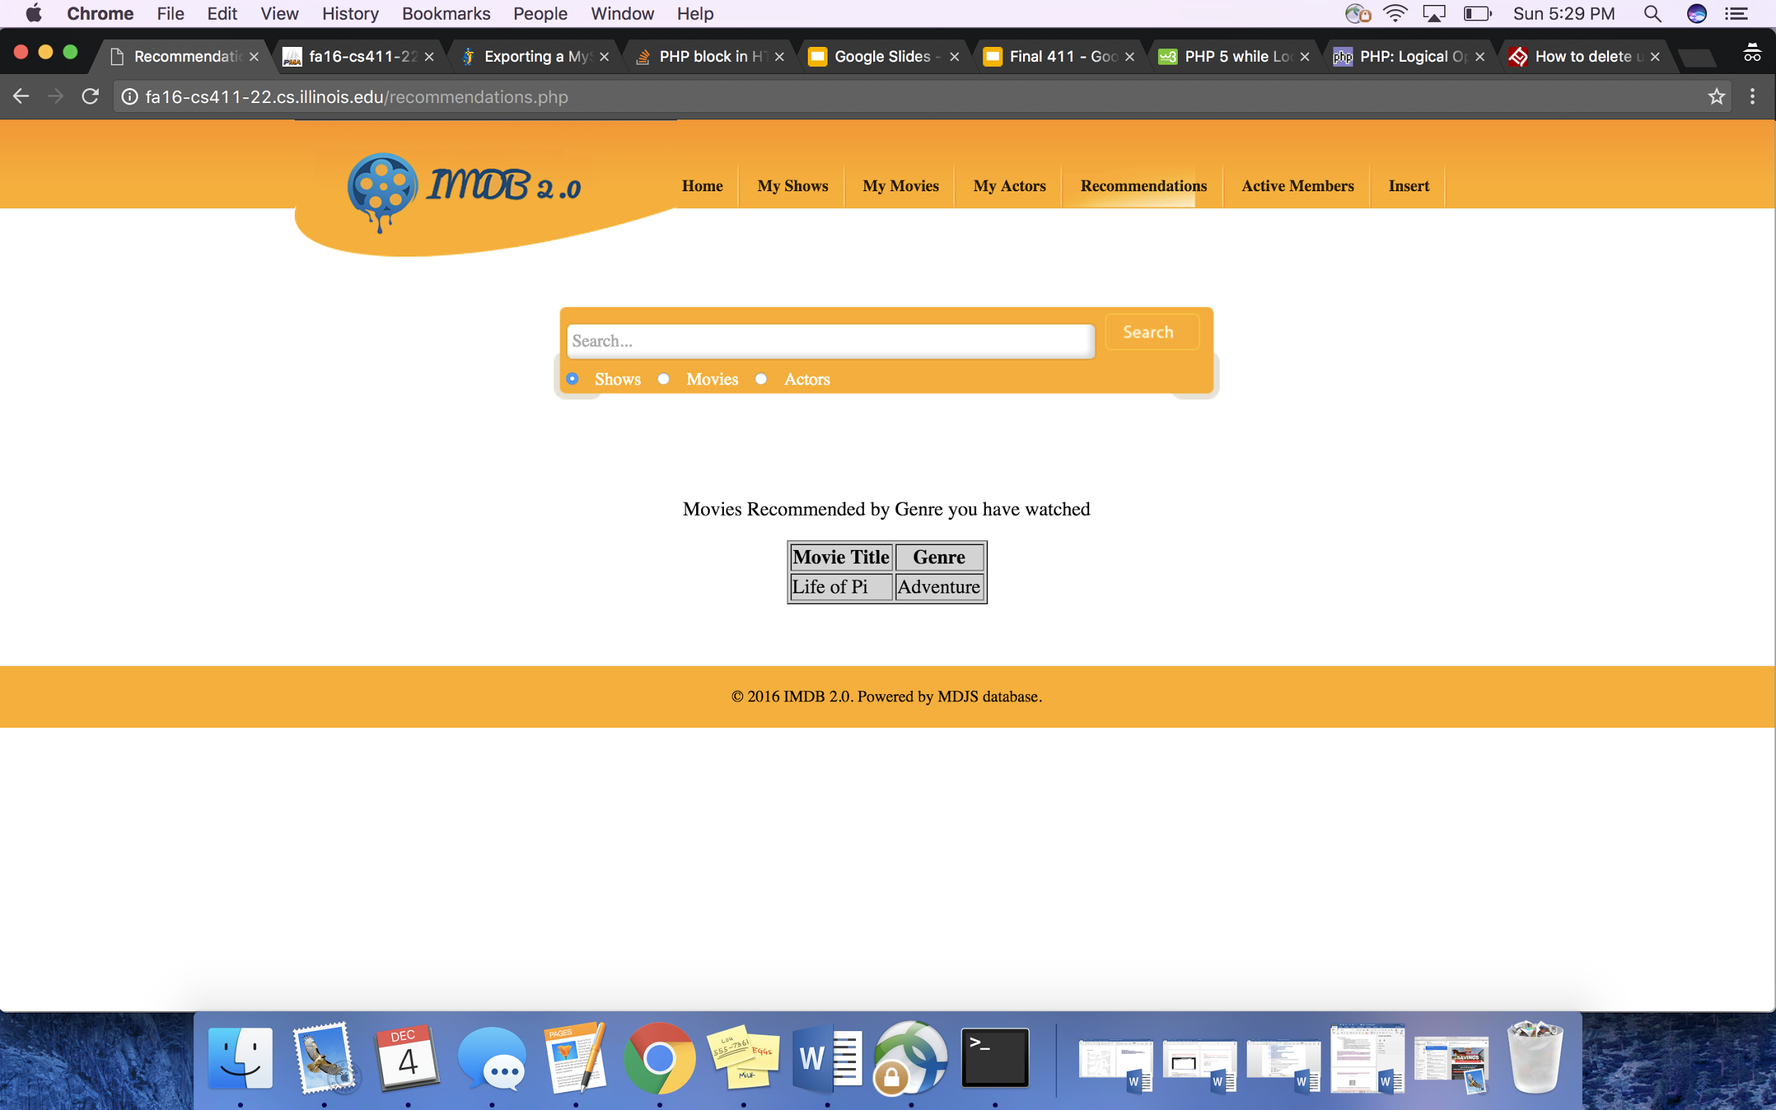
Recommendation Generator - if they have movies in their watch list
Get User ID of the User Id
Allows us to search the movies_watched table based on userid
Get Genre(s) they have watched
Give them recommendations on genres they watch
Find Movies that they have not watched from the movies watched table
So we do not recommend a movie they have already watched
Sort that by Rating provided by IMDB and Genre
Return Highest Rating Movie and having more than one like

Slide 8
Code for Recommendations
Find the genre(s)
$sql_genre= "SELECT DISTINCT info FROM movie_info, movies_watched WHERE info_type_id=3 and movie_info.movie_id = movies_watched.movie_id and movies_watched.id = $usr_id";
$main_sql = "SELECT DISTINCT title, MOVIES.id, movie_info_idx.info as rating
FROM movie_info, movies_watched, movie_info_idx, MOVIES
WHERE movie_info.info_type_id=3 and _info.movie_id = movies_watched.movie_id and
movie_info.info = $mike and movie_info_idx.info_type_id=101 and movie_info_idx.movie_id = movies_watched.movie_id and
movies_watched.movie_id NOT IN (SELECT DISTINCT movies_watched.movie_id FROM movie_info, movies_watched WHERE info_type_id=3 and movie_info.movie_id = movies_watched.movie_id and movies_watched.id = $usr_id)
and MOVIES.id = movie_info.movie_id
and MOVIES.likes >= 1
ORDER BY rating DESC
LIMIT 50";
$escond_sql = "SELECT title, id FROM ($real_sql) as tempTable ORDER BY rand() LIMIT 1";
Find Movies not
in your own watch list
Display the top
rated movie per genre the user watches with atleast 1 like by user

Slide 9
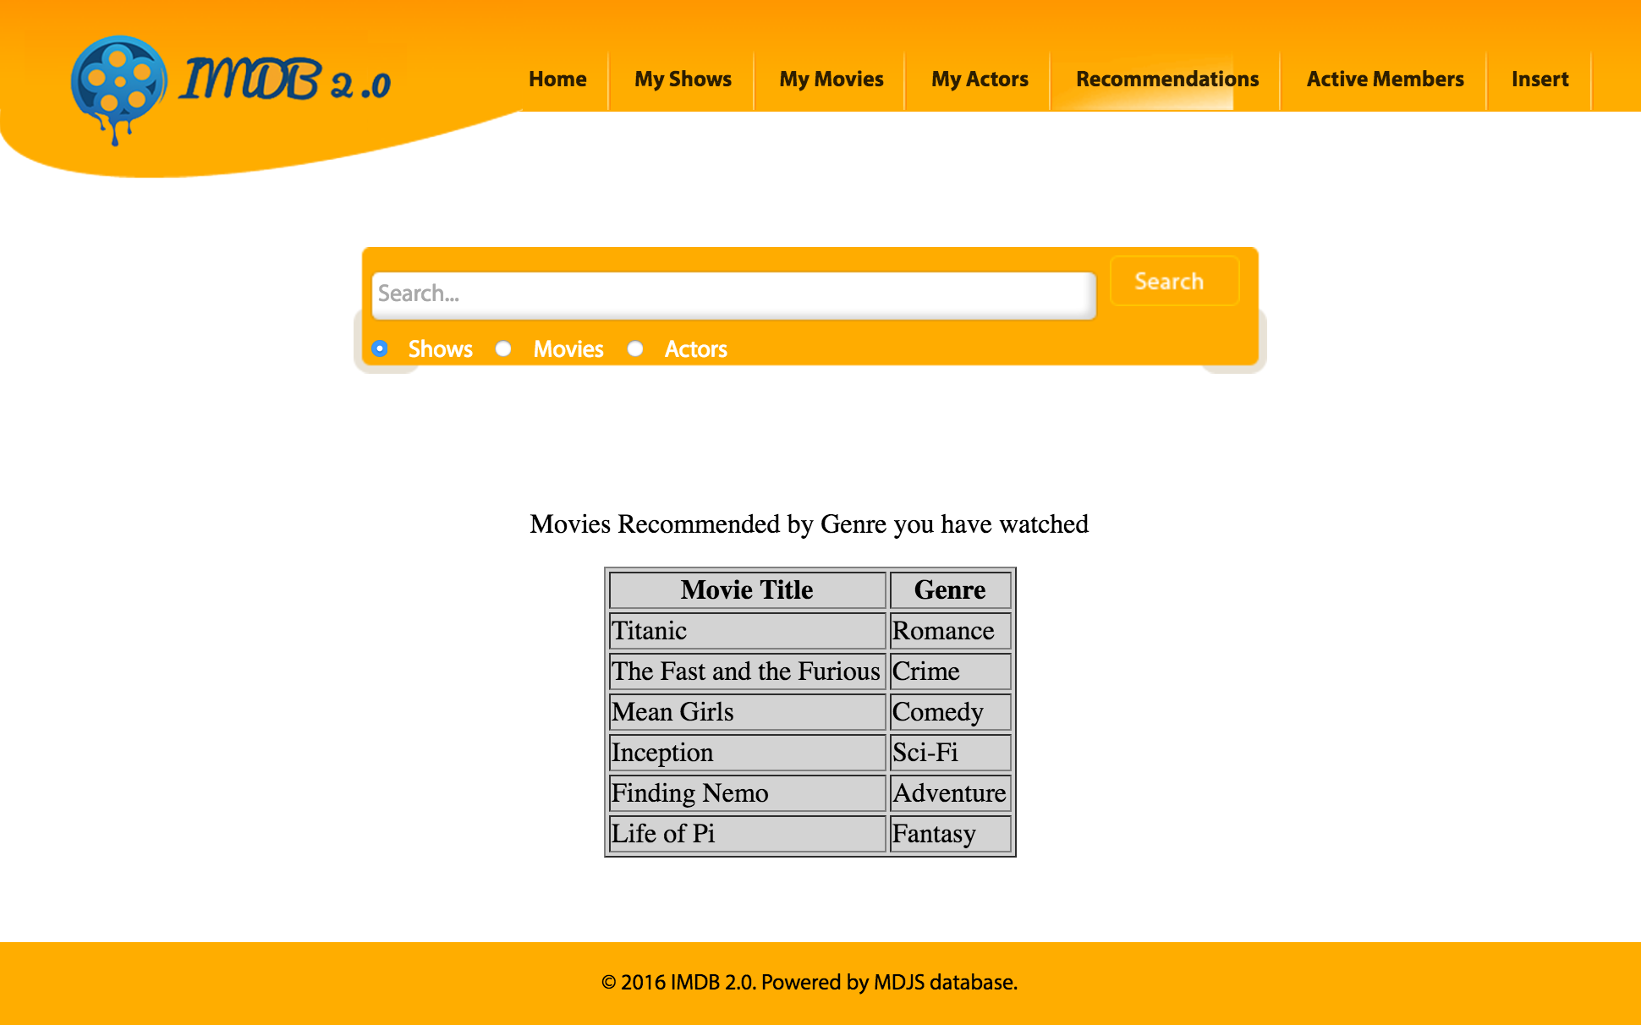
Recommendation Generator - if they are a new user without a watchlist
CONT
Get 10 Random Genre(s) other active users have watched
Give them recommendations on genres should they watch
Return the 5 Highest Rating Movie and having More than One Like
One per each genre
Trick Part:
We wanted to allow the users to have recommendations not only through a random search that could return bad values but have recommendations based on the movies their friends are watching. For this project we wanted to keep the design simple as our main goal was to allow users to see what their friends are watching. We also wanted our user interface to appeal to our audience and be simple. This project recommendations ties in the aspect of social media because you can see what others are watching.

